Slide 1
TIME SERIES
Rakhi Chandran
Assistant Professor
Department of Statistics
St. Mary’s College Thrissur

Slide 2
TIME SERIES
Set of values of a variable collected and recorded in chronological order of the time intervals.
Examples are Production, sales, population etc over 10 years.
Time Series, Rakhi Chandran, St.Mary’s College

Slide 3
UTILITY OF TIME SERIES
To know the past conditions
To assess the present achievments
To predict the future
It enables comparisons
It forewarns
Time Series ,Rakhi Chandran, St.Mary’s College

Slide 4
COMPONENTS OF TIME SERIES
Various forces affecting time series can be categorised into four component.
Secular trend
Seasonal Variations
cyclical variation
Irregular variation
Time Series,Rakhi Chandran, St.Mary’s College

Slide 5
SECULAR TREND
General tendency of data to increase or decrease over a long period of time.
Trend may be linear or non linear.
Time Series, Rakhi Chandran, St.Mary’s College

Slide 6
SEASONAL VARIATION
The Change that have taken place within a year as a result of change in climate, weather conditions, festivals etc.
Example: Sales of umbrellas is more during rainy season than in other season.
Time Series, Rakhi Chandran, St.Mary’s College

Slide 7
CYCLICAL VARIATIONS
Changes that have taken place as a result of Booms and Depressions
The Period is more than a year
In business cycle these are due to four phases
prosperity
decline
depression
improvement
Time Series, Rakhi Chandran, St.Mary’s College

Slide 8
CYCLICAL VARIATIONS
Changes that have taken place as a result of forces which is not predictable such as floods, earth quakes , famines etc.
The causes of some of them are known and are found irregular.
Some other causes are unknown.
Time Series, Rakhi Chandran, St.Mary’s College

Slide 9
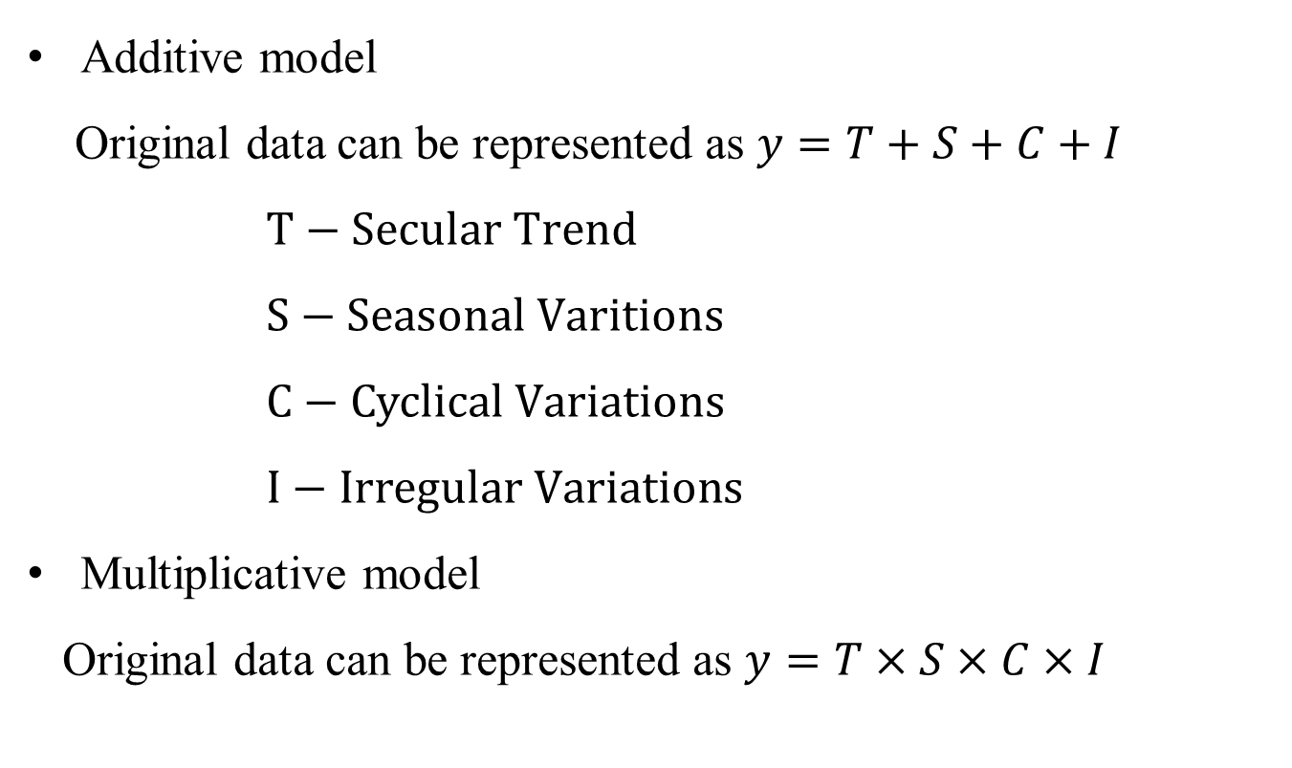
TIME SERIES MODELS
Additive model
Original data can be represented as $y=T+S+C+I$
$T−Secular Trend$
$S−Seasonal Varitions$
$C−Cyclical Variations$
$I−Irregular Variations$
Multiplicative model
Original data can be represented as $y=T×S×C×I$
Time Series, Rakhi Chandran, St.Mary’s College

Slide 10
MEASURMENT OF TREND
There are four methods to estimate trend
Graphic method
Semi Average method
Method of Moving Averages
Method of Least Squares
Time Series, Rakhi Chandran, St.Mary’s College

Slide 11
MEASURMENT OF SEASONAL VARIATION
There are four methods to estimate trend
Graphic method
Semi Average method
Method of Moving Averages
Method of Least Squares
Time Series, Rakhi Chandran, St.Mary’s College

Slide 12
THANK YOU
Time Series, Rakhi Chandran, St.Mary’s College

