Slide 1
CATALYSIS
Dr. Manju Sebastian
Assistant Professor
Department of Chemistry
St.Mary’s College, Thrissur

Slide 2
INTRODUCTION :Characteristics of a catalyst
Catalysis is a way of accelerating the rate of a chemical reaction by means of adding a substance called a catalyst, which itself is not consumed by the overall reaction.
A catalyst alters the rate of a chemical reaction without appearing in the end products.
Catalysts cannot make energetically unfavorable reactions possible.
Catalysts can not change the heat of a reaction.
A catalyst has an optimum temperature.
Catalysts can be poisoned.
Catalyst has a selectivity.

Slide 3
Promoters and catalyst poisons
Promoters enhance the activity of a catalyst
Eg: Mo in Haber process
The substance that destroy or reduce the activity is known as poisons
Eg: As is used as a poison in contact process

Slide 4
Types of catalysis
homogeneous catalysis
Reactants and catalyst are in the same phase
Eg-lead chamber process
SO_{2(g)}+O_{2(g)}---→ SO_{3(g)} using NO_{(g)} as catalyst
heterogeneous catalysis
Reactants and catalyst are in different phase
Contact process using Pt and V₂O₅ as catalysts

Slide 5
Theories of catalysis
Intermediate compound formation theory of homogeneous catalysis
Catalyst remain unchanged at the end of the reaction
Increase in catalyst concentration sometimes increases the rate
Specificity-catalyst enters into the reaction and influenced the path
A+B → AB
Step 1: A+C → AC
Step 2: AC + B → AB + C

Slide 6
Theories of catalysis
Adsorption theory of heterogeneous catalysis
Physisorption of reactants on to the surface of catalyst
Activated complex (molecules+catalyst)
Adsorbed activated complex to product (on surface)
Desorption

Slide 7
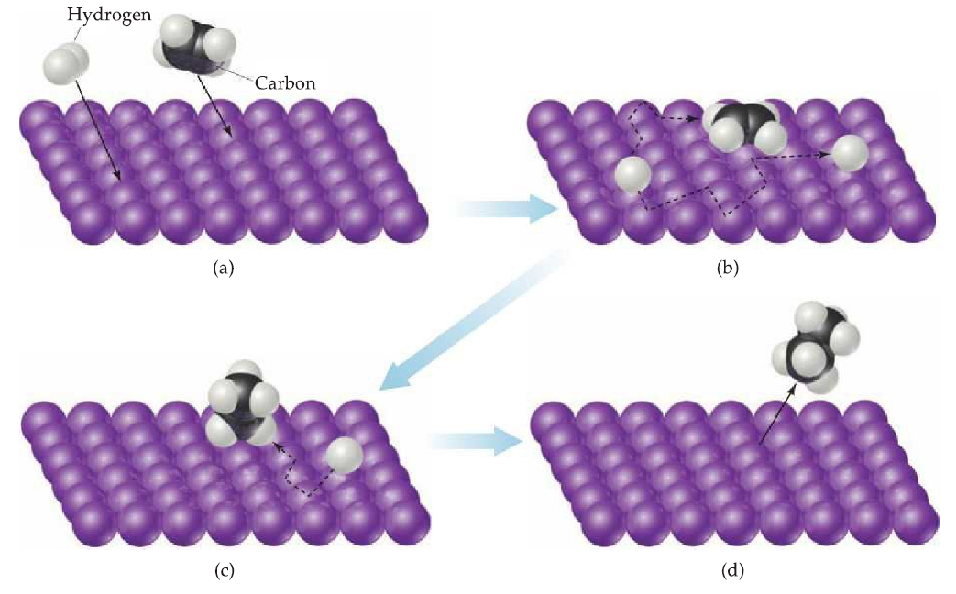

Slide 8
Enzyme Catalysis
An enzyme is a protein that acts as a biological catalyst.
The study of the rate at which an enzyme works is called enzyme kinetics.
two large classes of enzymes:
the hydrolytic enzymes
the oxidation-reduction enzymes.
enzyme catalysis is midway between homogeneous and heterogeneous catalysis.

Slide 9
General characteristics of enzyme and enzyme catalysis
High efficiency
Only small quantity is needed
Enzymes are unaltered during a reaction
Highly specific
pH dependent
Optimum temperature
Enzyme activators (enzyme regulators), enzyme inhibitors (enzyme modifiers)

Slide 10
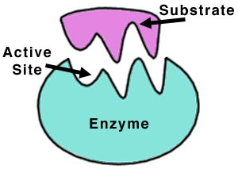
A substrate and the active site of enzyme

Slide 11
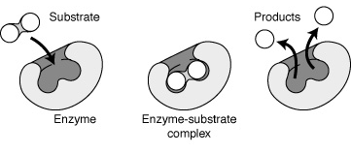
General mechanism of enzyme catalysis
Catalysis, Manju Sebastian, St Mary’s College

Slide 12
REFERENCES
A. S. Negi, S. C. Anand, A Textbook of Physical Chemistry, New Age Intnl, 1985
Ira N levine, Physical Chemistry, Tata McGraw-Hill Education, 2007
B.R. Puri, L.R. Sharma, M.S. Pathania, Principle of Physical Chemistry, VISHAL PUBLISHING Company, 01-Mar-2008

Slide 13
THANK YOU

